Slide 1
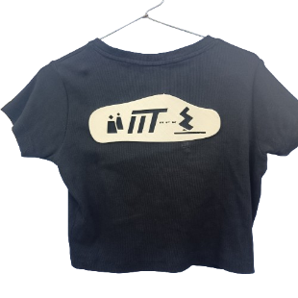
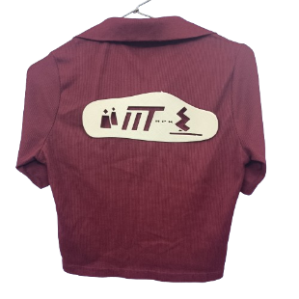
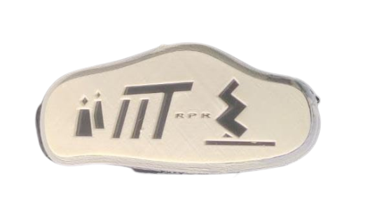
APPLICATIONS OF ADDITIVE MANUFACTURING IN THE CLOTHING INDUSTRY
“INFINTY WEAR”
Group
Korupolu Deekshitha – 2021MEB1292
Nishika Nakka – 2021MEB1301
Surkanti Sai Sahasra- 2021MEB1328

Slide 2
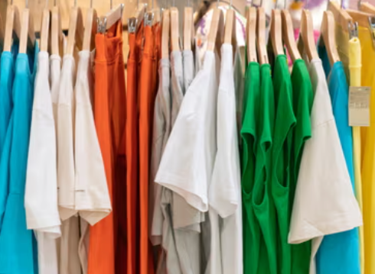
INTRODUCTION
- Clothing is a fundamental aspect of human life. In recent times, clothing industry is booming.
- Clothes are the most purchased items in the world.
-From functional attire designed for specific activities to fashion statements that express individuality.
But what are the consequences in the process of manufacturing, can we do something without compromising our needs?

Slide 3
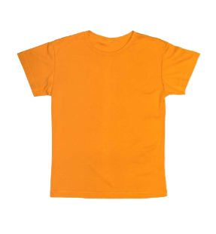
SUSTAINABILITY
Are All Clothes Sustainable ??
Use of Chemical Fertilizers
and Insecticides
Waste Generation
Water Pollution due to factories
Health Problems to Farm Workers

Slide 4
INFINITY WEAR
Aim - Address the issue of excessive textile waste and overconsumption in the fashion industry, by promoting logo customization and Transformation.
IDEA - Reduce the consumption of cloth by altering logos rather than purchasing new.
Material - We are using eco-friendly material like R-PLA(which is 100% recycled material).

Slide 5
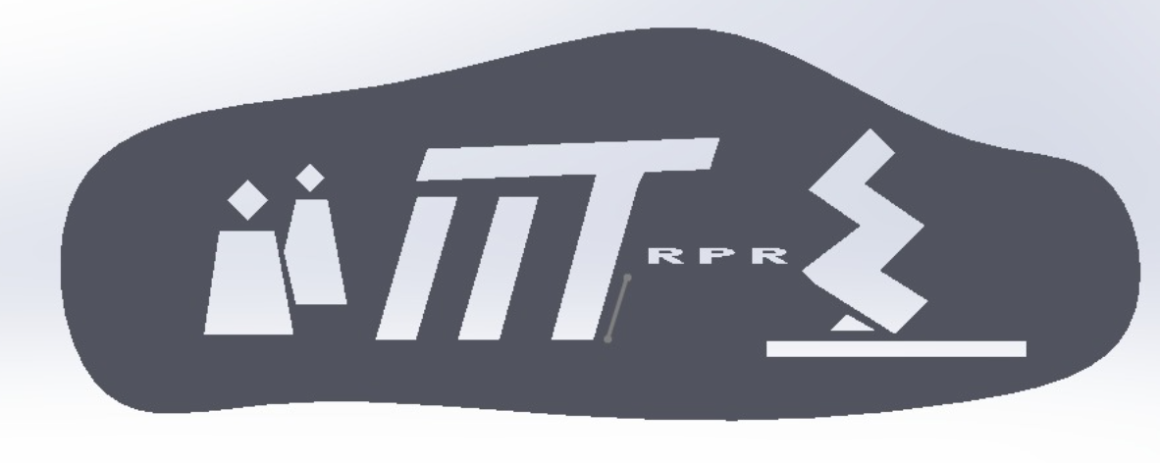
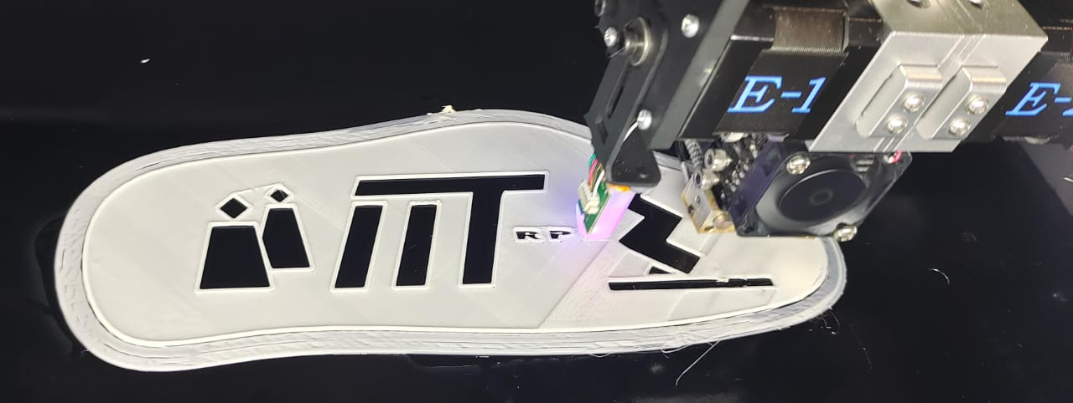
PROCEDURE
Make a CAD model according to the requirement.
Save it is an .stl file
Convert the .stl file into g-code {used cura software to convert .stl into g-code, also add material also diameter and other features. }.
Upload it to the desktop and print.
Attach it to the T-shirt.
CAD MODEL
3D PRINTING

Slide 6
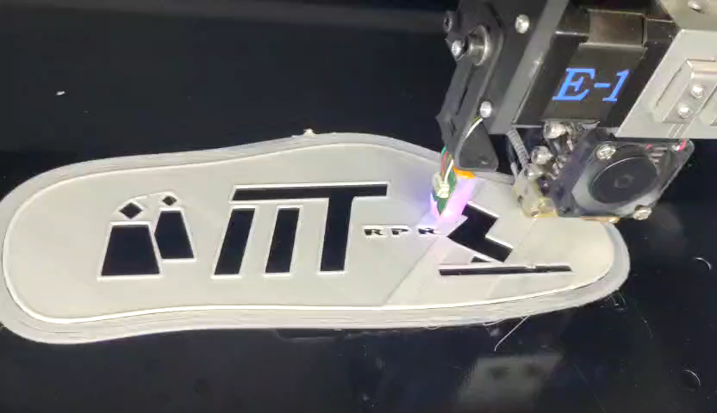
PROCEDURE

Slide 7
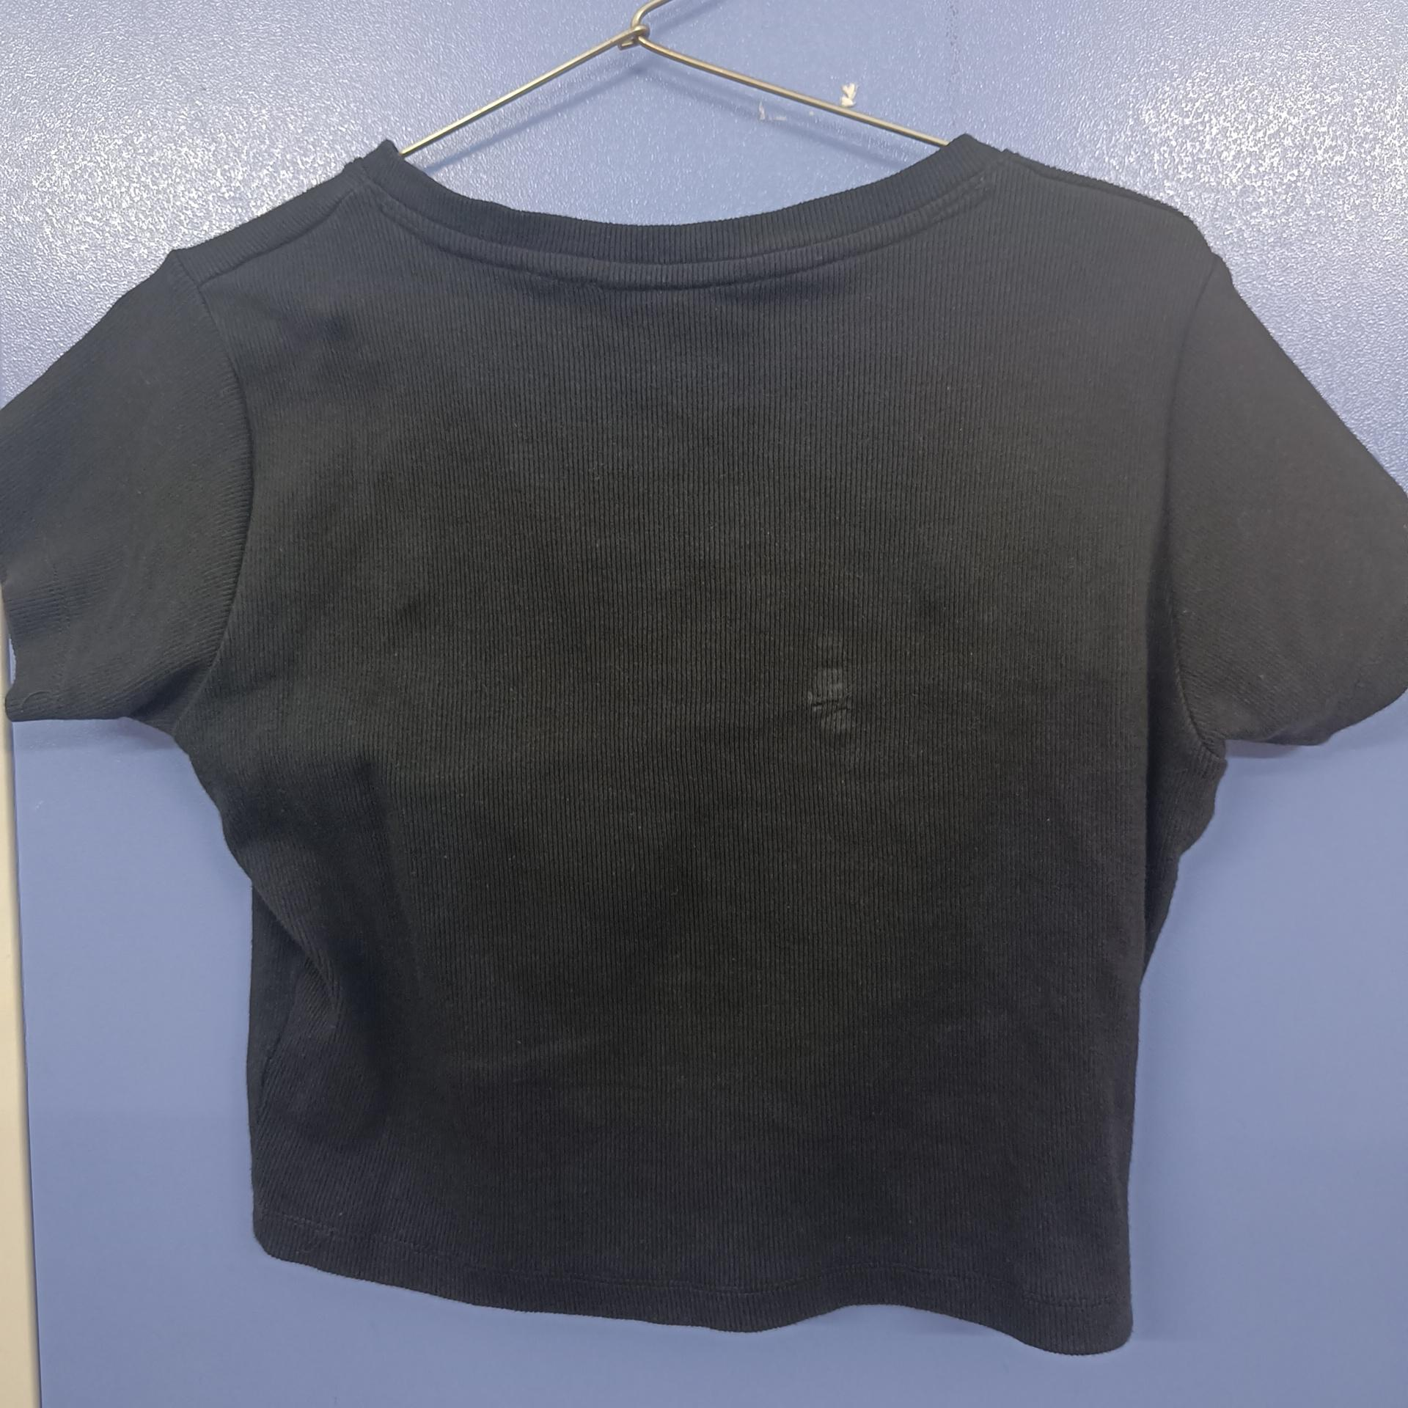
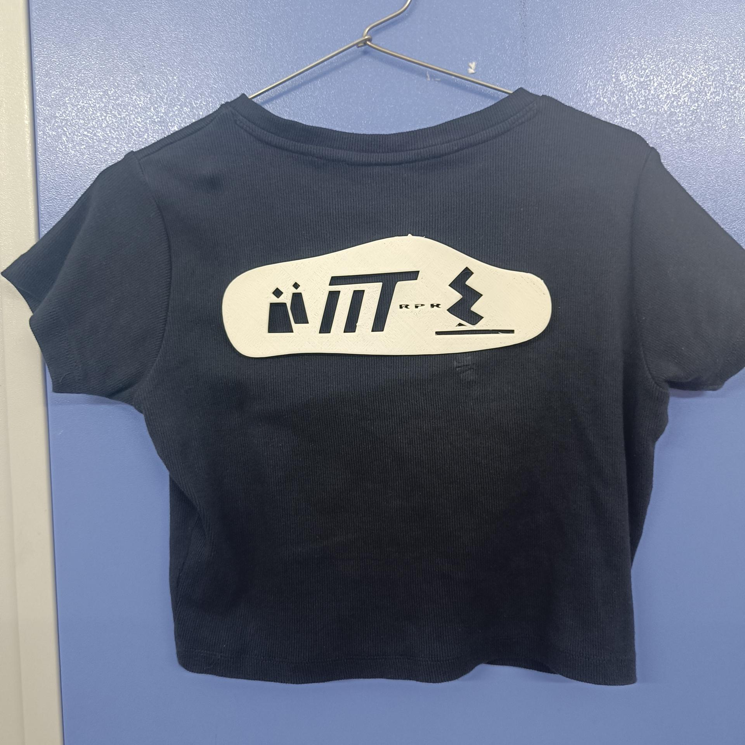
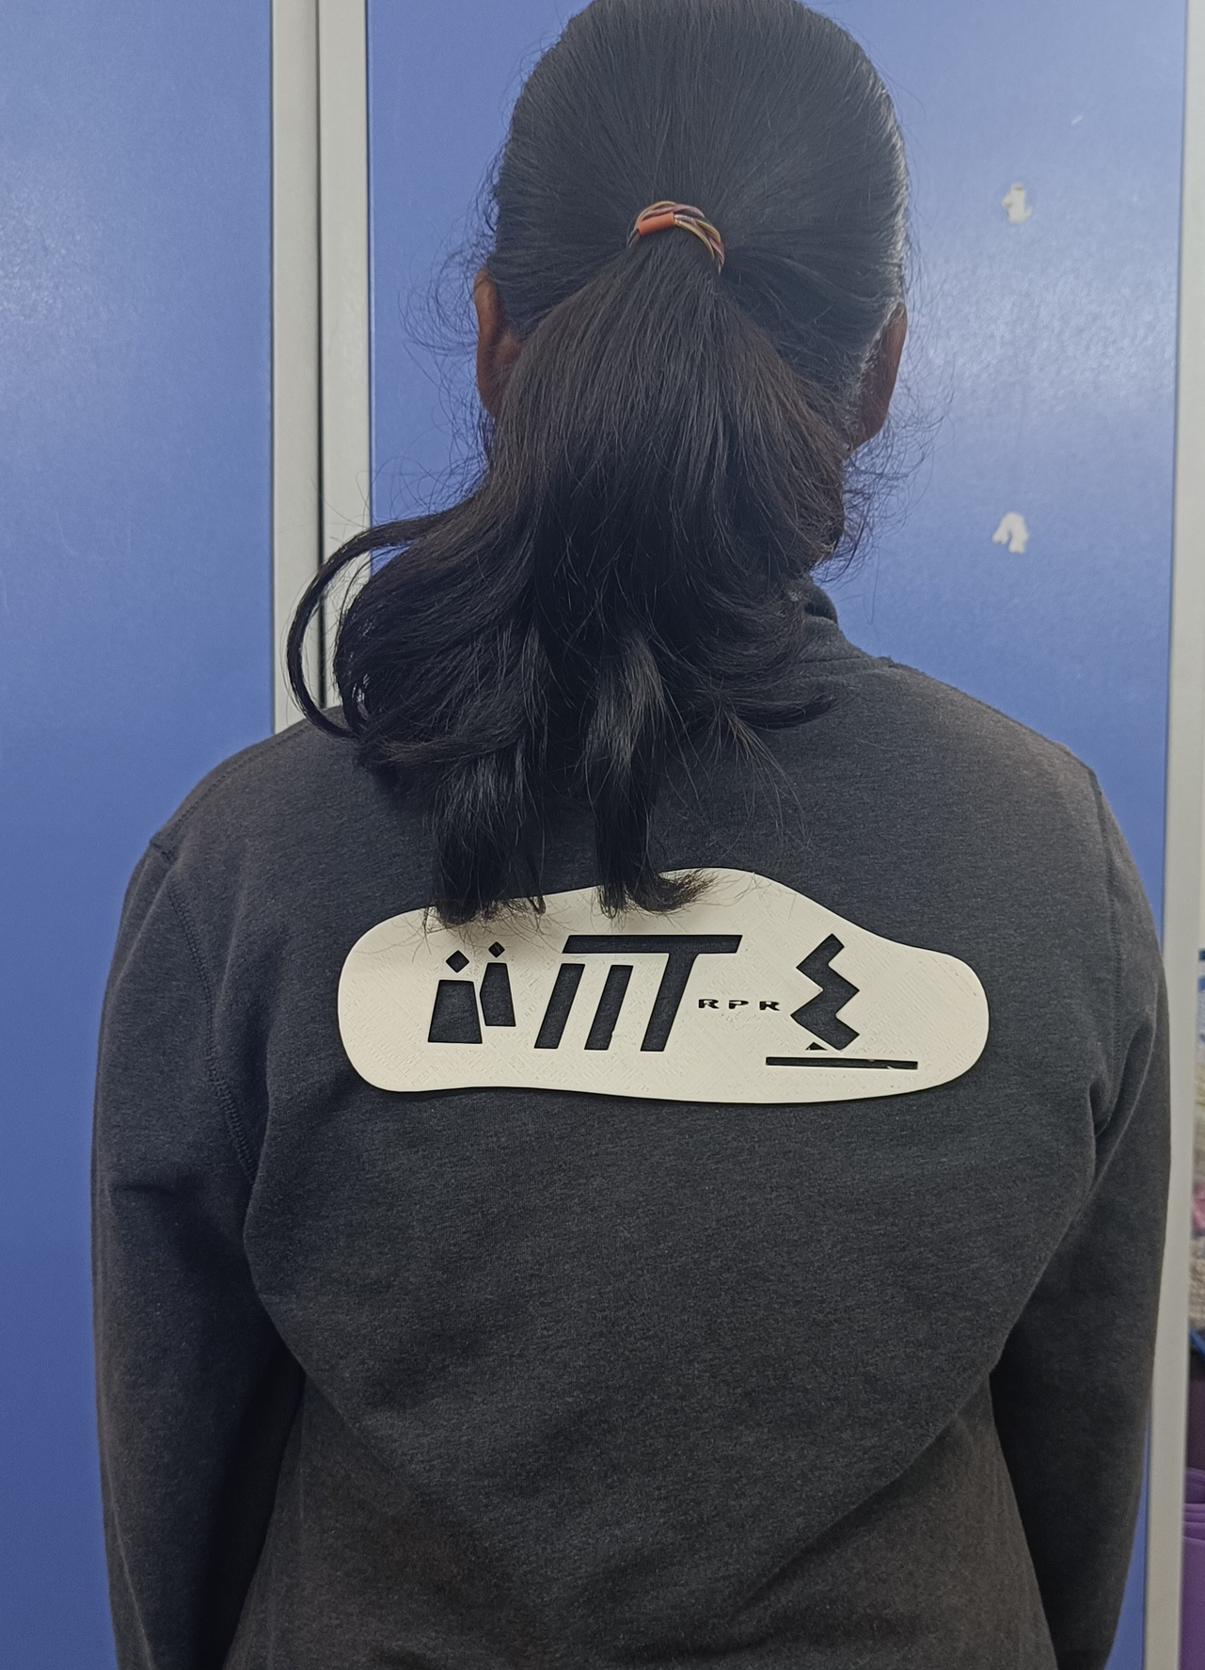
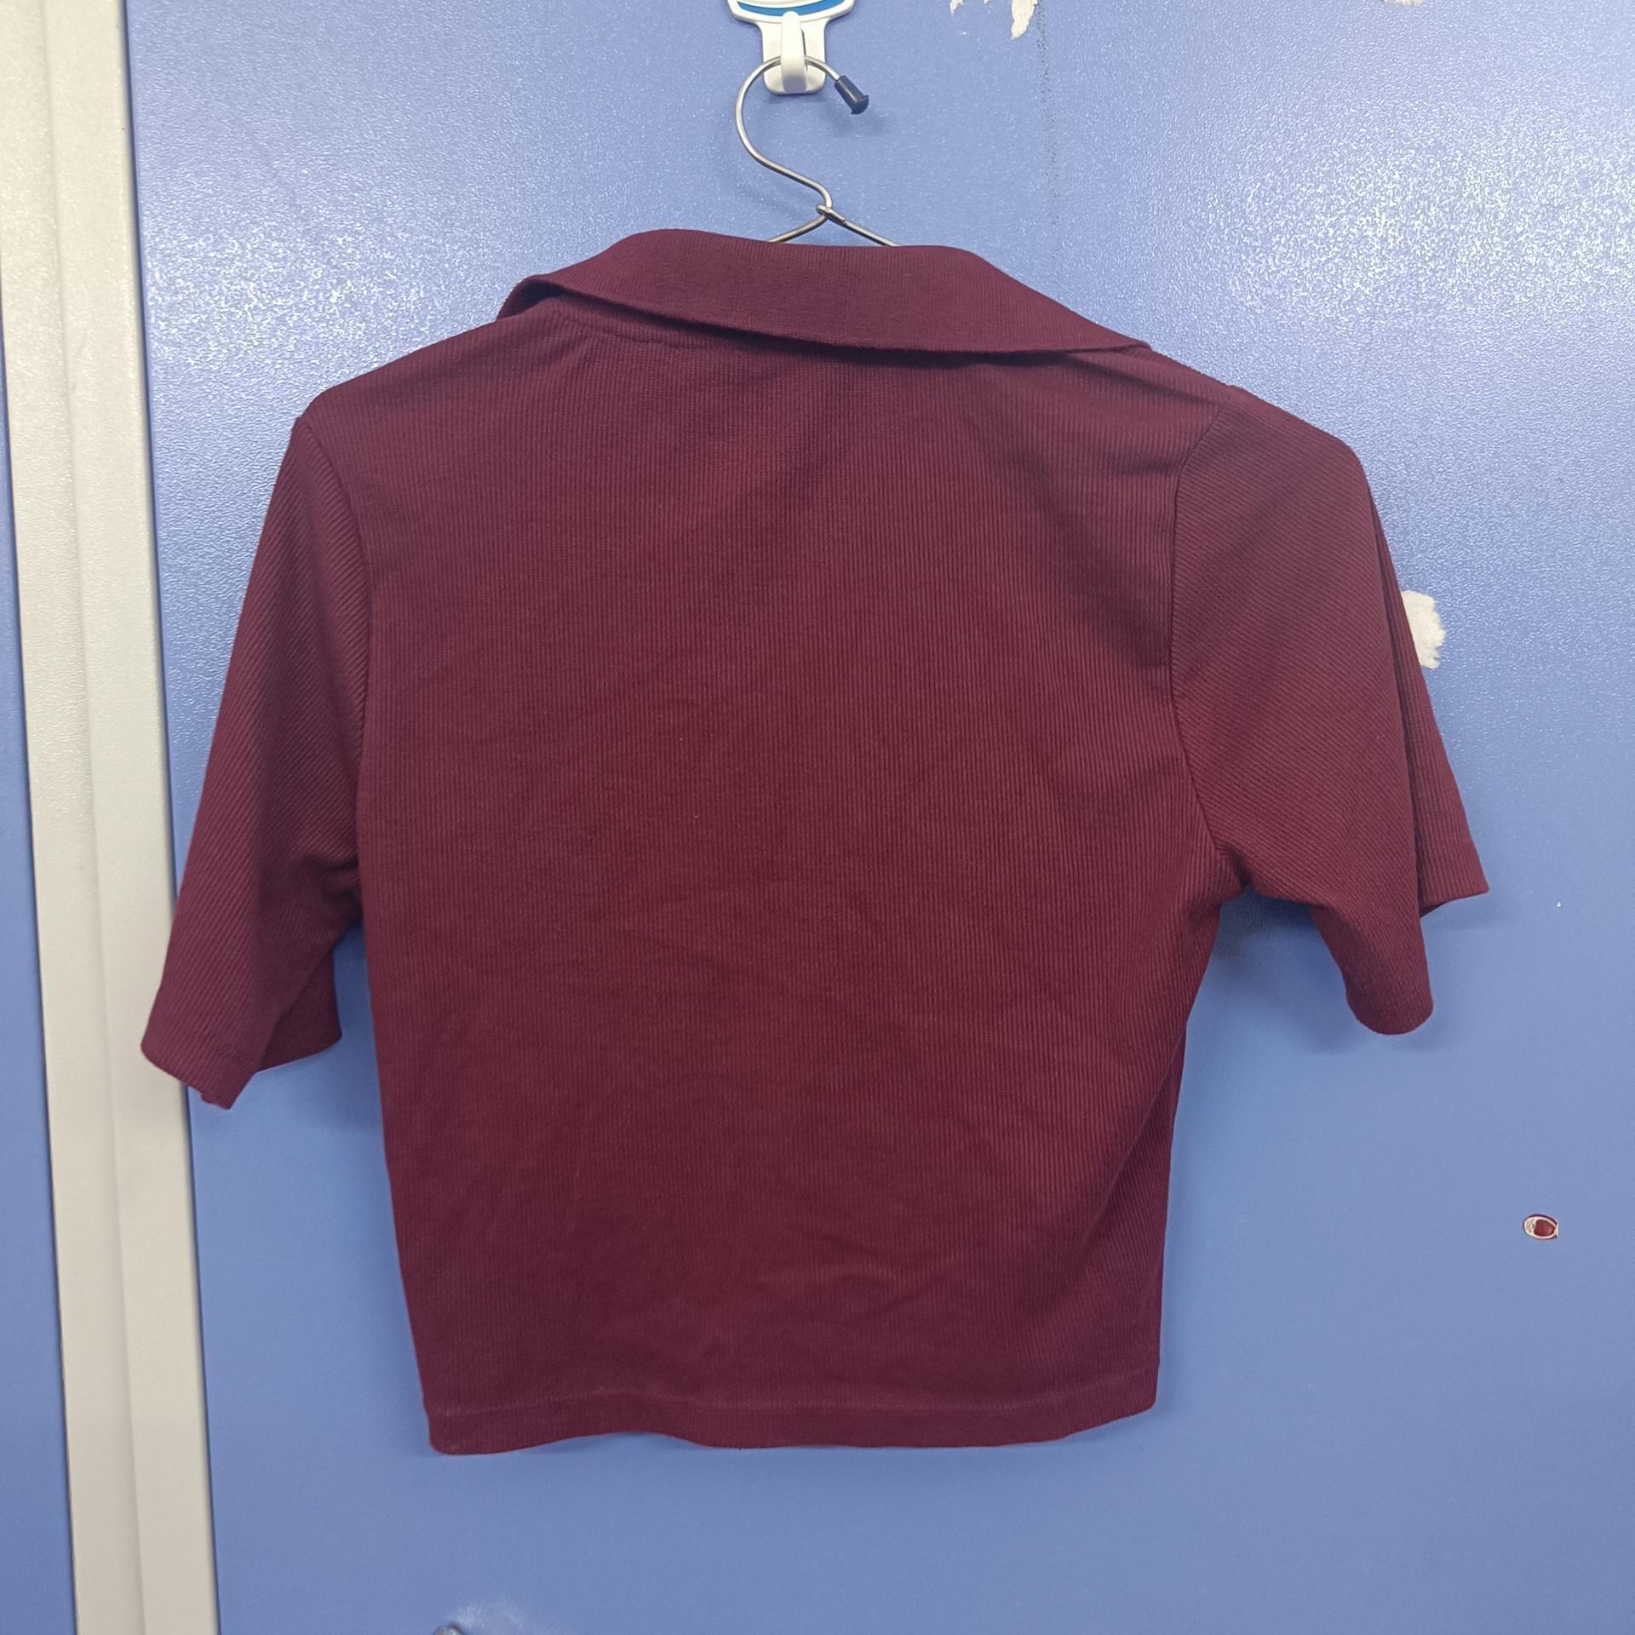
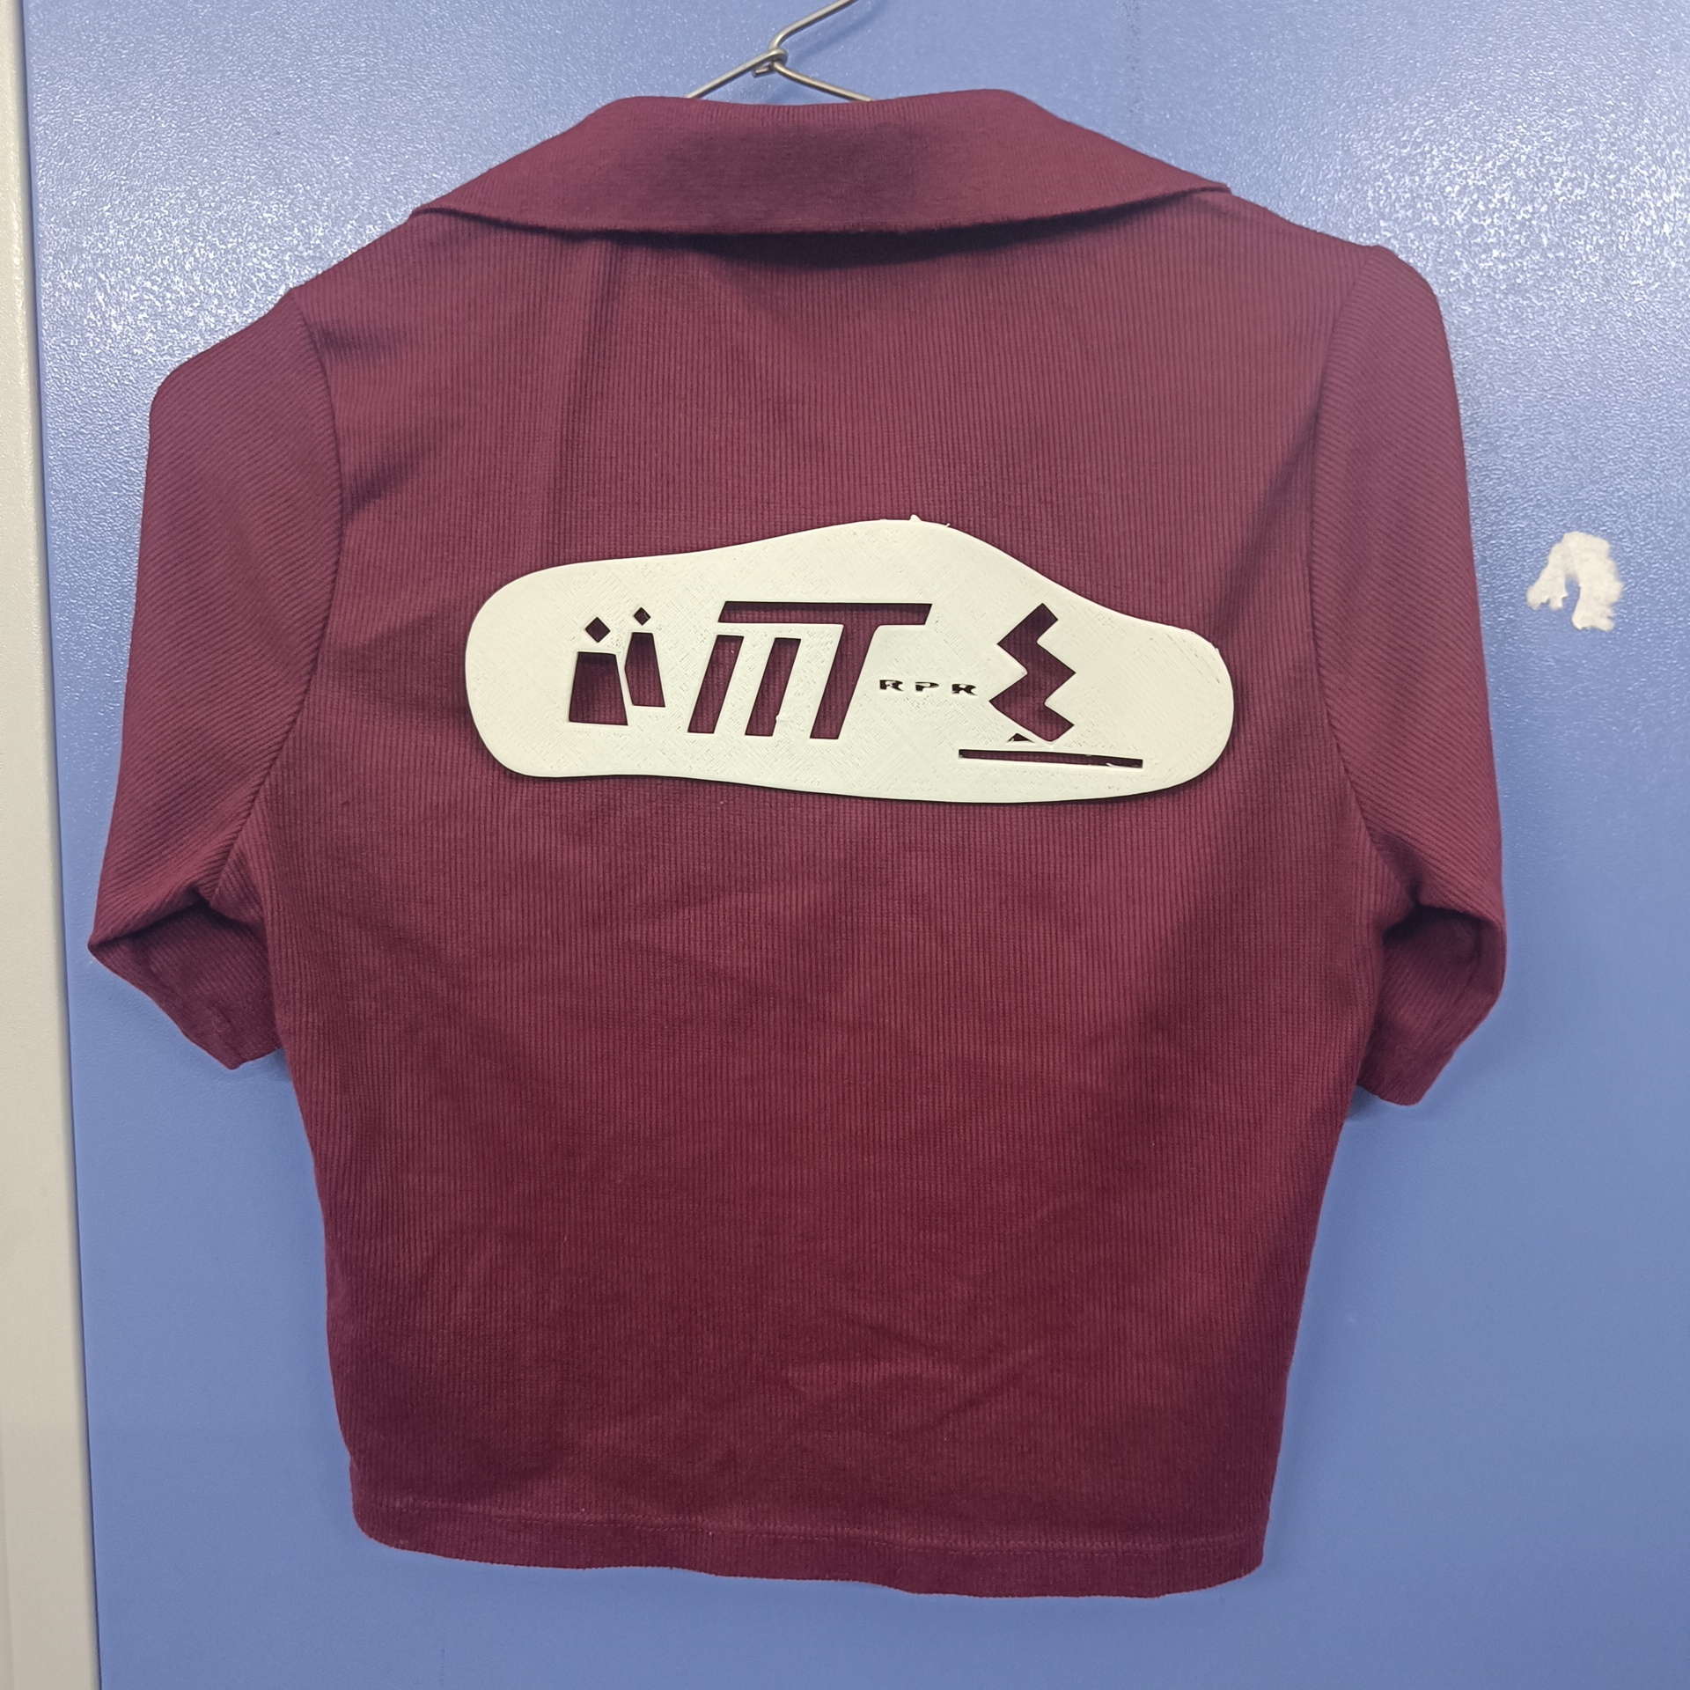
IMAGES

Slide 8
COST ANALYSIS
Additive Manufacturing offers advantages in inventory and transportation costs as well as supply chain management. Build time, energy consumption, and labor are also important factors that affect the cost.
Case – Assume we need 5 types of t-shirts for 5 events
Traditional Manufacturing - 5 x (cost of each T-shirt = 250) = 1250 Rupees
Additive Manufacturing - Machine Purchase (one time investment – ideally) – 2 Lakh
Material consumed=20 g (May vary with size)
The material spool cost=Rs 80/kg.
Other expenses(Electricity, labor costs, etc.)=60 Rs.
The cost of one logo= (1.6)+(60) = 62 , Cost of 5 logos=310 Rs.
Time to produce 5 logos= 4 hours ( may vary with size)
From this cost analysis, we can conclude that our idea of using replaceable logos is not only environmentally sustainable but also cost-effective. It reduces the cost of branding for five events from 1250 Rs to just 510 Rs, demonstrating a significant cost saving.

Slide 9
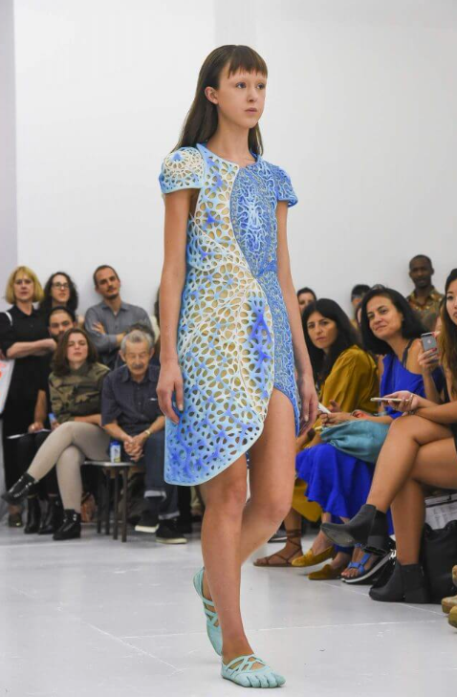
FUTURE SCOPE
NEED → FASHION
Production of Multiple Designs in various colors.
Expansion into Jewelry and footwear.
Application in the Aerospace & Defense suits.
Use of more eco-friendly materials.

Slide 10
CONCLUSION
In summary, our project promotes sustainability in the fashion industry by replacing the traditional t-shirt manufacturing approach.
Through the use of additive manufacturing, we have introduced replaceable logos on our t-shirts, reducing overproduction and waste.
This project aligns with a more environmentally responsible and customizable fashion future.

Slide 11
THANK YOU !!

